Slide 1

Practical 21
Write a Program to Implement Huffman coding.

Slide 2

Lesson Plan
Subject/Course | Competitive Coding
Lesson Title | Write a Program to Implement Huffman coding.
Lesson Objectives
Understand the concept and purpose of Huffman Coding for data compression.
Learn how to construct a Huffman Tree using character frequencies.
Write a program to generate Huffman Codes for given inputs.
Analyze the efficiency and applications of Huffman Coding in real-world use.

Slide 3
Problem Statement:
Write a Program to Implement Huffman coding.
Problem Overview
Given a string S of distinct character of size N and their corresponding frequency f[ ] i.e. character S[i] has f[i] frequency. Your task is to build the Huffman tree print all the huffman codes in preorder traversal of the tree.

Slide 4
Note:
While merging if two nodes have the same value, then the node which occurs at first will be taken on the left of Binary Tree and the other one to the right, otherwise Node with less value will be taken on the left of the subtree and other one to the right.
Example 1:
S = "abcdef"
f[] = {5, 9, 12, 13, 16, 45}
Output:
0 100 101 1100 1101 111
Explanation:
HuffmanCodes will be:
f : 0
c : 100
d : 101
a : 1100
b : 1101
e : 111

Slide 5
Concept:
What is Huffman Coding?
Huffman Coding is a lossless compression technique that reduces file size by encoding data efficiently.
It assigns shorter binary codes to more frequent characters and longer codes to less frequent ones.
This method ensures that no code is a prefix of another, making decoding unique and reliable.
It was developed by David A. Huffman in 1952 and is widely used in compression tools.

Slide 6
Concept:
Why Huffman Coding?
Data compression helps in saving storage space and reducing transmission time.
Huffman coding ensures that frequently used symbols consume fewer bits.
It provides one of the most efficient variable-length encoding schemes.
Applications include ZIP files, JPEG, MP3, and communication protocols.

Slide 7
Concept:
Steps in Huffman Coding
Count the frequency of each character in the data.
Create a min-heap (priority queue) containing all characters with their frequencies.
Repeatedly extract two smallest nodes and merge them into one node.
Continue until one node remains, which becomes the root of the Huffman Tree.

Slide 8
Concept:
Example – Building the Tree
Given Input:
A:5, B:9, C:12, D:13, E:16, F:45
Step 1: Combine A and B → Node(14)
Step 2: Combine C and D → Node(25)
Step 3: Combine Node(14) and E → Node(30)
Step 4: Continue merging until one root node remains → Node(100)

Slide 9
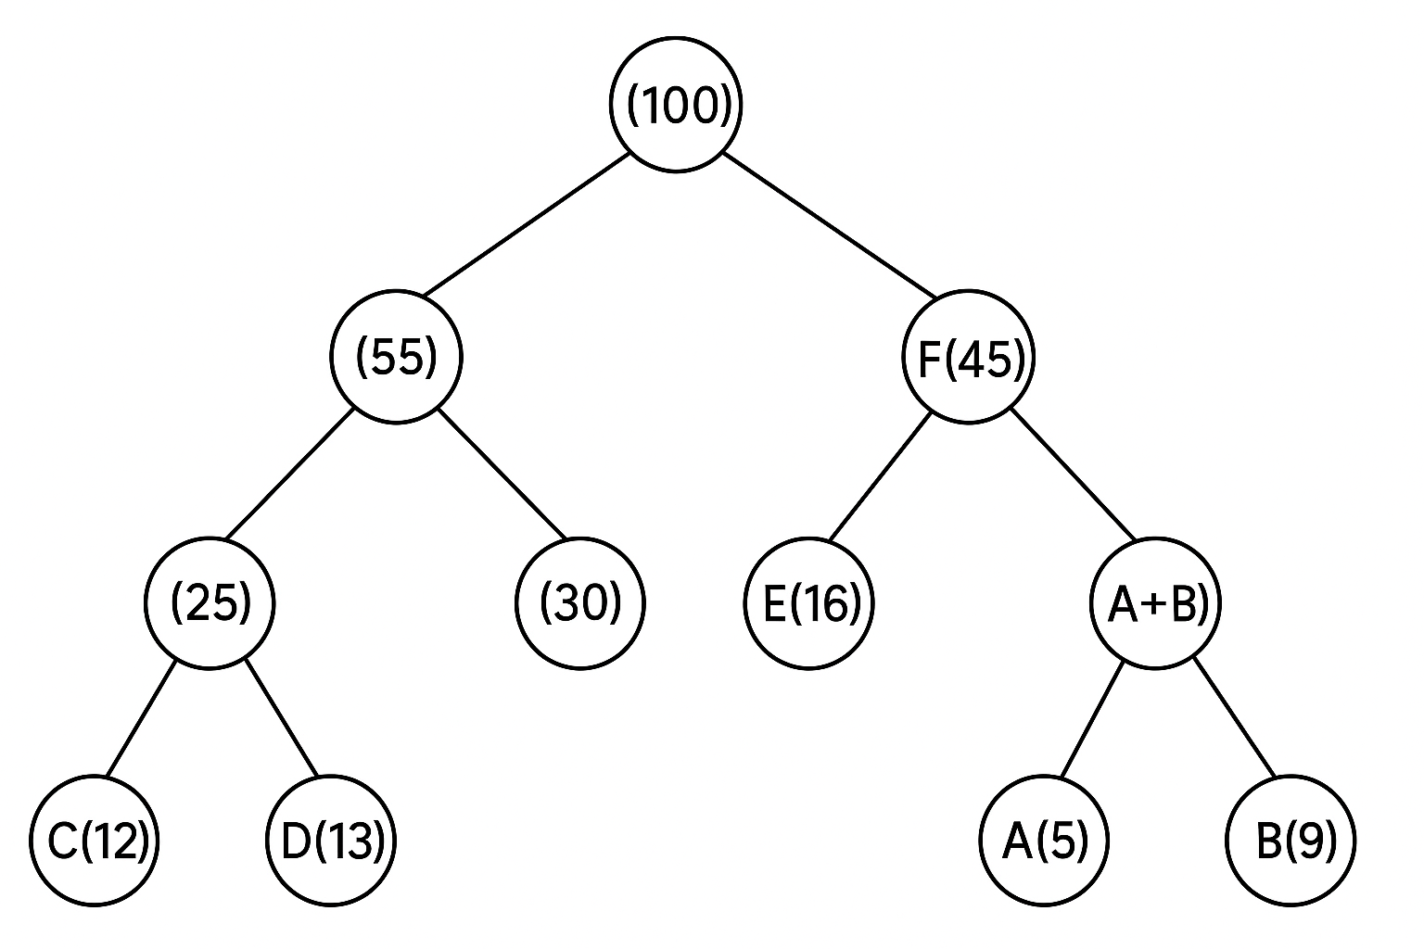
Huffman Tree Visualization

Slide 10
Algorithm / Pseudocode
Insert all characters into a priority queue with their frequencies.
While more than one node exists, remove two smallest nodes and combine them.
Insert the new merged node back into the queue.
When one node remains, traverse the tree assigning ‘0’ for left and ‘1’ for right to generate codes.

Slide 11
Code Implementation
import java.util.PriorityQueue;
class Node {
char ch;
int freq;
Node left, right;
Node(char ch, int freq) {
this.ch = ch;
this.freq = freq;
this.left = null;
this.right = null;
}
}

Slide 12
class HuffmanCoding {
// Print Huffman Codes from the root of Huffman Tree
static void printCodes(Node root, String s) {
if (root == null) return;
// If it's a leaf node, print the character and its code
if (root.left == null && root.right == null) {
System.out.println(root.ch + ": " + s);
return;
}
printCodes(root.left, s + "0");
printCodes(root.right, s + "1");
}

Slide 13
public static void main(String[] args) {
char[] chars = {'A', 'B', 'C', 'D', 'E', 'F'};
int[] freq = {5, 9, 12, 13, 16, 45};
// Create a priority queue (min-heap) based on frequency
PriorityQueue<Node> pq = new PriorityQueue<>((a, b) -> a.freq - b.freq);
// Create leaf nodes for each character and add to the queue
for (int i = 0; i < chars.length; i++) {
pq.add(new Node(chars[i], freq[i]));
}

Slide 14
while (pq.size() > 1) {
// Extract the two nodes with minimum frequency
Node left = pq.poll();
Node right = pq.poll();
// Create a new internal node with a combined frequency
Node sum = new Node('$', left.freq + right.freq);
sum.left = left;
sum.right = right;
// Add the new node to the priority queue
pq.add(sum);
}
// Print the Huffman codes
printCodes(pq.peek(), "");
}
}

Slide 15
Output
Output (for given input):
F: 0
C: 100
D: 101
A: 1100
B: 1101
E: 111

Slide 16
Summary
Huffman Coding efficiently compresses data by reducing total bits used.
It uses frequency-based tree construction to assign unique variable-length codes.
The algorithm’s complexity is O(n log n) due to the use of a min-heap.
It remains one of the most widely used lossless compression techniques in computing.

Slide 17
Practice Questions:
1️⃣ Kth Largest Element in an Array
Link: https://leetcode.com/problems/kth-largest-element-in-an-array/
Description:
Find the k-th largest element in an unsorted array using a min-heap or priority queue.
Concept Reinforced: Heap operations, element comparison, and top-k pattern.
Difficulty: 🟡 Medium

Slide 18
Practice Questions:
2️⃣ Top K Frequent Elements
Link: https://leetcode.com/problems/top-k-frequent-elements/?utm_source=chatgpt.com
Description:
Given an integer array, return the k most frequent elements using hash map + heap.
Concept Reinforced: Frequency counting, priority queue usage — similar to Huffman frequency logic.
Difficulty: 🟡 Medium

Slide 19
Practice Questions:
3️⃣ Kth Smallest Element in a Sorted Matrix
Link: https://leetcode.com/problems/kth-smallest-element-in-a-sorted-matrix/?utm_source=chatgpt.com
Description:
Find the k-th smallest element in a sorted matrix using a min-heap or binary search approach.
Concept Reinforced: Heap-based selection and efficient traversal — extends Huffman Tree’s greedy concept.
Difficulty: 🟡 Medium

Slide 20
Thanks

